Slide 1

Movie rental data analysis
- Presented By
Deeksha r

Slide 2

Project Introduction
This project involves the analysis of the MovieOnRent store with data related to DVD rentals of movies . The store wants to know what kind of movies are most rented, genres it belongs to, the actors in it,etc.Through SQL queries we try to identify the trends and patterns in this dataset.

Slide 3

About dataset
Sakila is a database that has details of the Rental store which stores movies in DVD and and Blu-ray discs formats.
The management wants to analyse the data to know which type of movies and actors people are renting often. It has various tables such as films, customers, staff, and stores. The database provides information about film titles, actors, customers, rental transactions, inventory, and payment details.

Slide 4
IMplementation of project
1. Define and Plan: This step involves understanding the project's goals, objectives.
2. Analysis: This step involves collecting and preprocessing data, exploring and understanding the dataset.
3. Present and Document: This step involves documenting the project's process and creating a presentation or report to communicate the findings and outcomes.
Define and Plan -----> Analysis -----> Present & Document

Slide 5
Description of methods used:
Used the Sakila database to solve queries using the already existing tables under it.
Used several SQL Commands like select, distinct , count, where clause , joins, like operator and so on for extracting only required values.
Used inner joins to combine two different tables on the basis of a common column in order to retrieve values available in both the tables

Slide 6
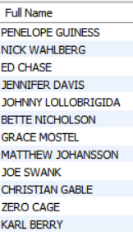
TASK 1
Question:
Display the full names of actors in database
QUERY:
select concat(first_name,' ', last_name) as 'Full Name' from actor

Slide 7
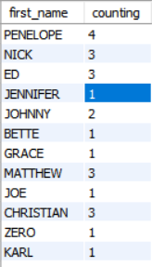
TASK 2
Question:
Display the number of times each first name appears in database
QUERY:
select first_name ,count(first_name) as counting from actor group by first_name

Slide 8
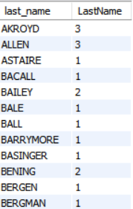
TASK 3
Question:
Display the number of times each last name appears in database
QUERY:
select last_name, count(last_name) as LastName from actor group by last_name

Slide 9
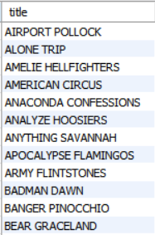
TASK 4-Part A
Question:
Display the records of movies with rating ’R’
QUERY:
select title from film where rating='R'

Slide 10
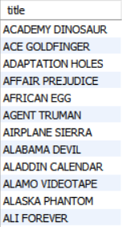
TASK 4-Part B
Question:
Display the records of movies without rating ’R’
QUERY:
select title from film where rating !='R'

Slide 11
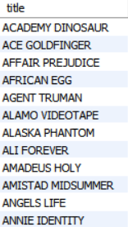
TASK 4-Part C
Question:
Display the records of movies with rating that is suitable for audience below 13 years
QUERY:
select title from film where rating ='PG' or rating='G'

Slide 12
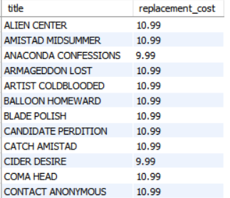
TASK 5-Part A
Question:
Display the list of records with movies where replacement cost is upto $11
QUERY:
select title , replacement_cost from film where replacement_cost<=11

Slide 13
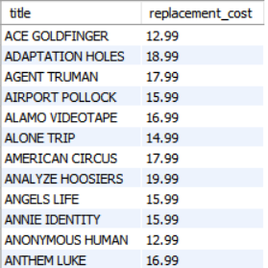
TASK 5-Part B
Question:
Display the list of records with movies where replacement cost is between $11and $20
QUERY:
select title , replacement_cost from film where replacement_cost between 11 and 20

Slide 14
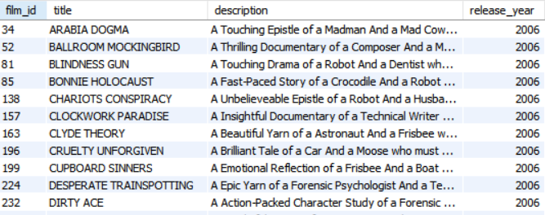
TASK 5-Part C
Question:
Display the list of records for all movies in desc order of replacement cost
QUERY:
select * from film order by replacement_cost desc

Slide 15

TASK 6
Question:
Display the top 3 movies that have more no.of actors in it
QUERY:
select f.title, count(a.actor_id) as actor_count from film as f join film_actor as fa on f.film_id=fa.film_id join actor as a on fa.actor_id=a.actor_id group by f.film_id order by actor_count desc limit 3

Slide 16
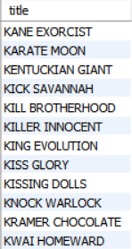
TASK 7
Question:
Display the list of movies that starts with letter K and Q
QUERY:
select title from film where title like 'K%' or title like'Q%'

Slide 17
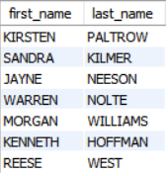
TASK 8
Question:
Display the list of all actors from film ‘Agent Truman’
QUERY:
select a.first_name,a.last_name from actor as a join film_actor as fa on fa.actor_id=a.actor_id join film as f on f.film_id=fa.film_id where title ='Agent Truman'

Slide 18
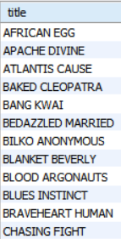
TASK 9
Question:
Display the list of movies categorized as Family genre
QUERY:
select title from film join film_category as fc on film.film_id = fc.film_id join category as c on fc.category_id=c.category_id where c.name='Family'

Slide 19
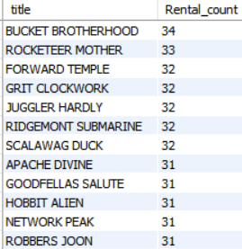
TASK 10
Question:
Display the movies in desc order of rental frequency
QUERY:
select f.title , count(r.rental_id) as Rental_count from film as f join inventory as i on f.film_id=i.film_id join rental r on i.inventory_id=r.inventory_id group by f.title order by Rental_count desc

Slide 20

TASK 12
Question:
Display the film category in which no.of films is more than 70
QUERY:
select c.name, COUNT(fc.film_id) as counting from category as c join film_category as fc on fc.category_id=c.category_id group by c.name having counting>70

